Slide 1
PROJECT TITLE: SECURE DATA HIDING IN IMAGES USING STEGANOGRAPHY
CAPSTONE PROJECT
Presented By:
Student Name : KRITHIGA U
College Name & Department : SAVEETHA ENGINEERING COLLEGE & ARTIFICIAL INTELLIGENCE AND MACHINE LEARNING DEPT

Slide 2
OUTLINE
Problem Statement
Technology used
Wow factor
End users
Result
Conclusion
Git-hub Link
Future scope

Slide 3
Problem Statement
In today’s digital world, securing sensitive information is a major concern. This project, Secure Data Hiding in Images Using Steganography, aims to embed secret messages within images using pixel manipulation. By leveraging encryption techniques, this system ensures that confidential data remains hidden from unauthorized access while being transmitted securely.

Slide 4
Technology used
Programming Language: Python
Libraries:
OpenCV (for image processing)
numpy (for numerical operations)
Platform: Works on Windows, Linux, and macOS
(Used Visual Studio Code here)

Slide 5
Wow factors
✅ Stealthy Encryption – Unlike traditional encryption, this method hides data within an image instead of producing visible encrypted text. ✅ Passcode Protection – Only authorized users with the correct passcode can retrieve the hidden message. ✅ Optimized Performance – The decryption process stops as soon as the message is extracted, reducing execution time. ✅ Multi-Channel Encoding – Uses RGB channels for data hiding, making detection even more difficult.

Slide 6
End users
Government & Military – For covert communication in national security.
Cybersecurity Professionals – To test and analyze steganography-based attacks.
Journalists & Whistleblowers – For securely sharing sensitive information.
General Users – Who want to hide private messages from unauthorized access.

Slide 7
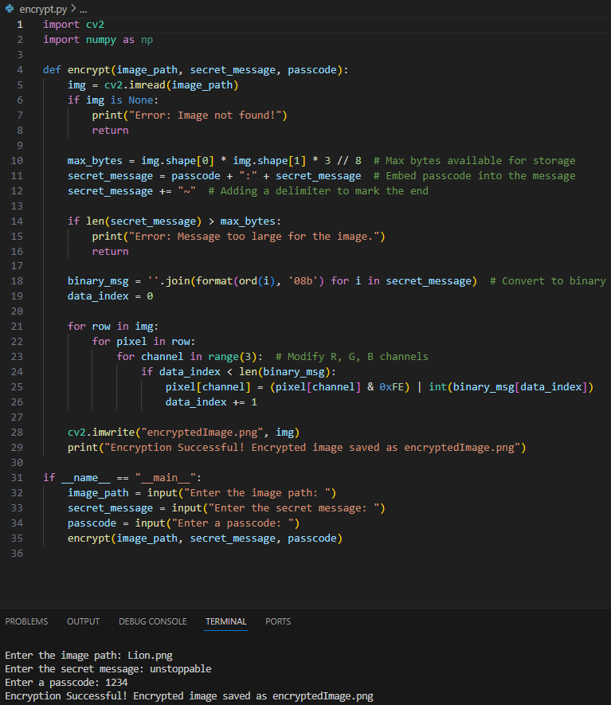
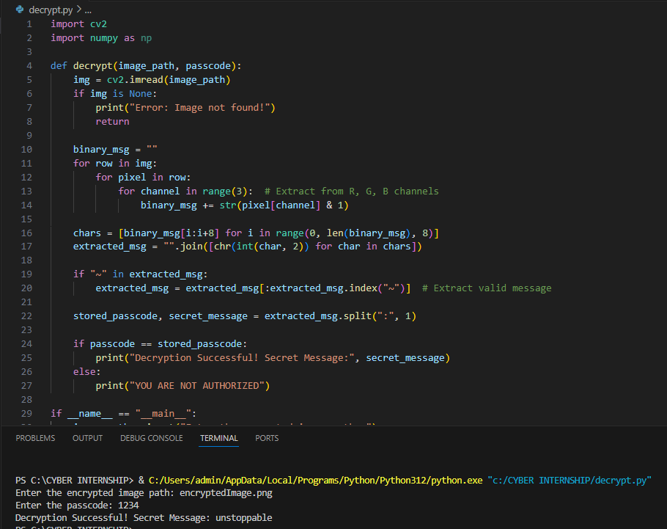
Results

Slide 8
Conclusion
This project demonstrates a practical steganography-based data hiding technique using images as carriers for secure communication.
The combination of encryption, passcode protection, and optimized decryption makes it an efficient and secure method of message hiding.

Slide 9
GitHub Link
https://github.com/krithigau/Stego-AICTE

Slide 10
Future scope(optional)
Advanced Steganography – Implementing adaptive hiding techniques based on image complexity.
AI-Powered Security – Using machine learning to detect and prevent steganalysis attacks.
Mobile & Web Application – Creating Android/iOS apps or a browser-based tool for easy access.
Blockchain Integration – Storing encryption metadata on decentralized networks for enhanced security.

Slide 11
THANK YOU

